Slide 1
In-situ Resource Utilization (ISRU) for propellant production on Mars
ME 370C: ENERGY SYSTEMS
FINAL PRESENTATION
Rishav Choudhary, Mohammed Ayub
06/06/2017

Slide 2
Contents
Objectives
Methanation
Reactor modelling
Kinetics
Results
3) Methane Properties
Helmholtz fundamental relations
Results
4) Liquefaction Unit
Heylandt liquefaction system
Results
5) Conclusions
2

Slide 3

Objectives

Slide 4
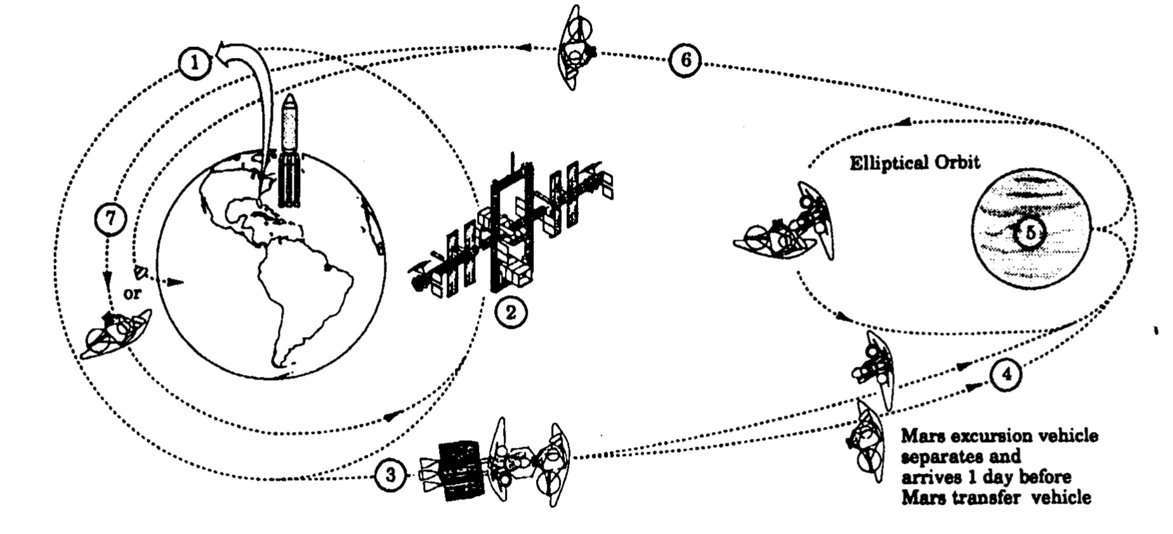
Why Mars ISRU?
Objectives
Methanation
Methane Prop.
Liquefaction
Conclusion
“Gear Ratio” = mass in LEO/landed mass on Mars surface = ~10
WITHOUT ISRU
Mars Ascent Vehicle (dry mass) = ~6 tons
Fuel + Oxidizer + Life Support = ~29 tons
Total Landing Mass = ~35 tons
WITH ISRU
Total Landing Mass = ~10 tons
Mass to be lifted to LEO reduced by 60%
Saves billions of $
4

Slide 5
Conversion of carbon dioxide to methane
Objectives
Methanation
Methane Prop.
Liquefaction
Conclusion
CO₂ is present in abundance in the atmosphere. H₂O can be mined from the regolith
Sabatier reaction converts CO₂ to CH₄
Objectives:
Model methanation reactor as a 1-D fixed-bed catalyst reactor
Use three global reactions to model kinetics
Estimate the concentration at reactor exit, and its sensitivity to operating conditions
5

Slide 6
Methane Properties, Separation, & Liquefaction
Objectives
Methanation
Methane Prop.
Liquefaction
Conclusion
Objectives:
Use Helmholtz fundamental relations to get accurate properties for CH₄
Separate unreacted CO₂ from the product stream
Liquefy CH₄ using a Heylandt cycle
6

Slide 7
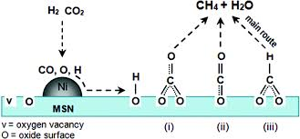
Methanation

Slide 8
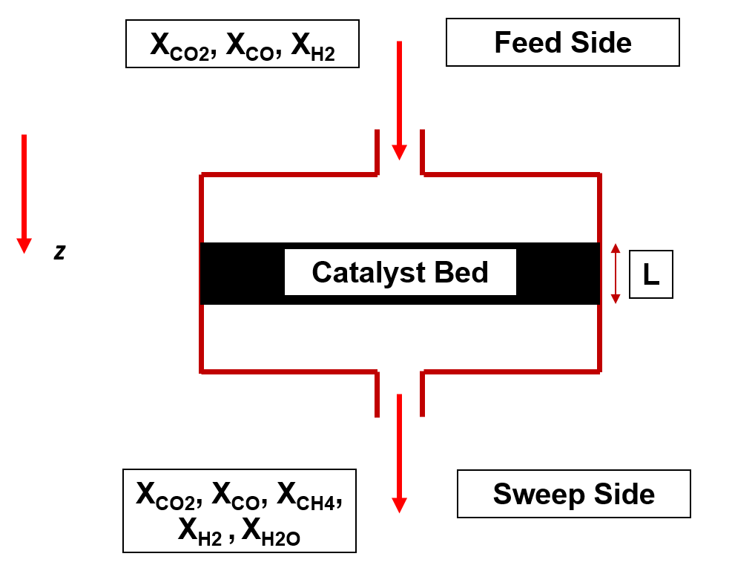
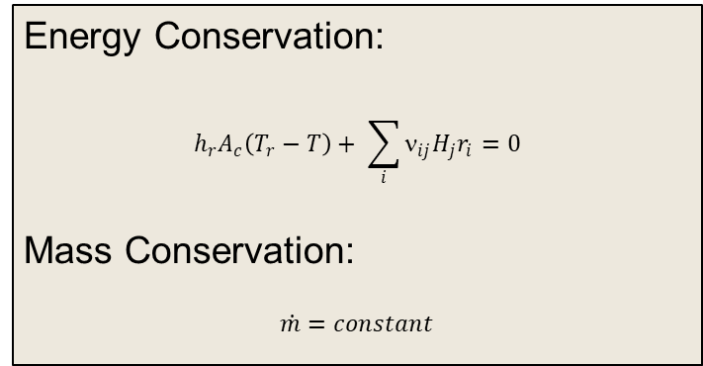
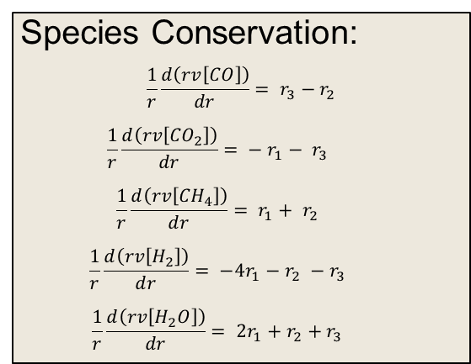
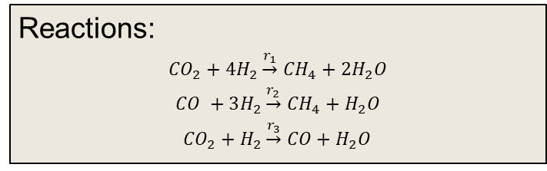
Reactor model
Objectives
Methanation
Methane Prop.
Liquefaction
Conclusion
Assumptions:
Fixed bed catalyst reactor (Ni/Al₂O₃ catalyst)
1-D steady flow
Negligible diffusive transport
No internal resistance to mass transfer
Adiabatic
Reactions:
${CO}_{2}+4H_{2}\underset{→}{r_{1}}$ ${CH}_{4}+2H_{2}O$
$CO +3H_{2}\underset{→}{r_{2}}$ ${CH}_{4}+H_{2}O$
${CO}_{2}+H_{2}\underset{→}{r_{3}}$ $CO+H_{2}O$
Species Conservation:
$$\frac{1}{r}\frac{d\left(rv\left[CO\right]\right)}{dr}= r_{3}−r_{2}$$
$$\frac{1}{r}\frac{d\left(rv\left[{CO}_{2}\right]\right)}{dr}= − r_{1}− r_{3}$$
$$\frac{1}{r}\frac{d\left(rv\left[{CH}_{4}\right]\right)}{dr}= r_{1}+ r_{2}$$
$$\frac{1}{r}\frac{d\left(rv\left[H_{2}\right]\right)}{dr}= −4r_{1}−r_{2} −r_{3}$$
$$\frac{1}{r}\frac{d\left(rv\left[H_{2}O\right]\right)}{dr}= 2r_{1}+r_{2}+r_{3}$$
Energy Conservation:
$$h_{r}A_{c}\left(T_{r}−T\right)+ \sum_{i}{ν_{ij}H_{j}r_{i}}=0$$
Mass Conservation:
$$\dot{m}=constant$$
8
Notes:
As a laser emits light onto the gas in a test section, the gas absorbs the light and thereby causes the intentuation of the intensity of the incident light.
Beer-Lambert’s law relates the absorbance by a uniform gas intensity of the incident light to the attenuated light intensity which is proportional to the mole fraction of the absorbing specieis where sigma is a gas property (absorption corss-section), total number density of the gas n and optical path-length, L

Slide 9
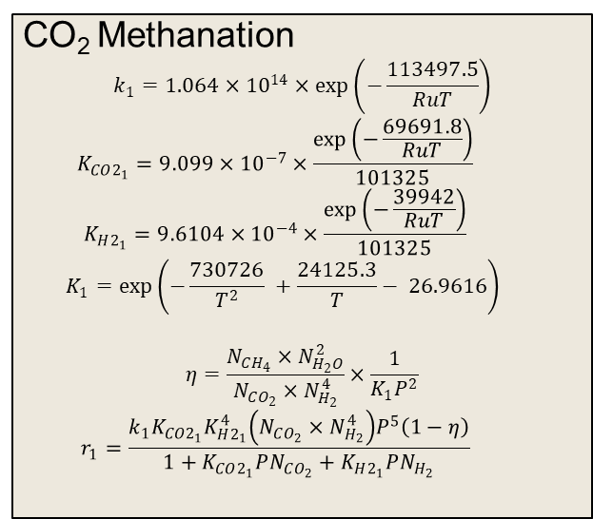
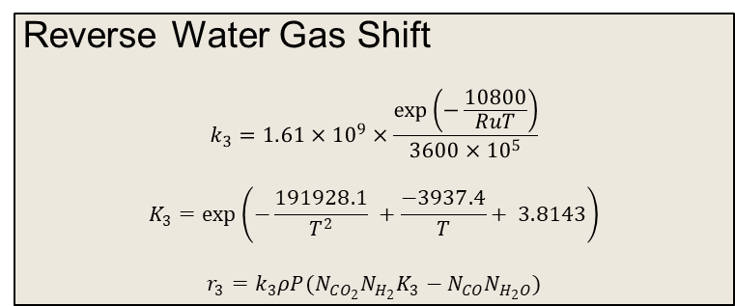
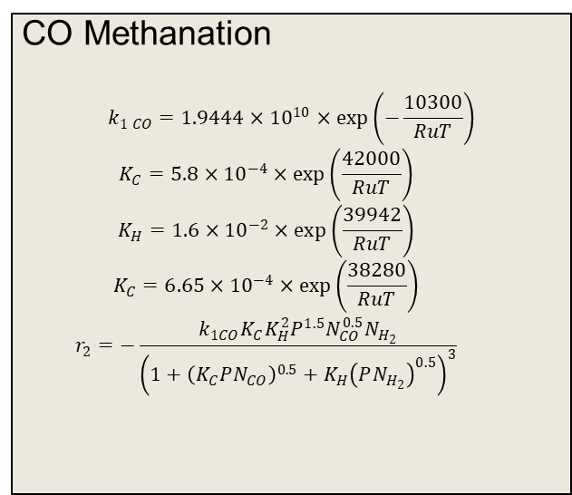
Reaction Rates
Objectives
Methanation
Methane Prop.
Liquefaction
Conclusion
CO₂ Methanation
$$k_{1}=1.064×{10}^{14}×\exp\left(−\frac{113497.5}{RuT}\right)$$
$$K_{CO2_{1}}=9.099×{10}^{−7}×\frac{\exp\left(−\frac{69691.8}{RuT}\right)}{101325}$$
$$K_{H2_{1}}=9.6104×{10}^{−4}×\frac{\exp\left(−\frac{39942}{RuT}\right)}{101325}$$
$$K_{1}=\exp\left(−\frac{730726}{T^{2}} +\frac{24125.3}{T}− 26.9616\right)$$
$$η=\frac{N_{CH_{4}}×N_{H_{2}O}^{2}}{N_{CO_{2}}×N_{H_{2}}^{4}}×\frac{1}{K_{1}P^{2}}$$
$$r_{1}=\frac{k_{1}K_{CO2_{1}}K_{H2_{1}}^{4}\left(N_{CO_{2}}×N_{H_{2}}^{4}\right)P^{5}\left(1−η\right)}{1+K_{CO2_{1}}PN_{CO_{2}}+K_{H2_{1}}PN_{H_{2}}}$$
CO Methanation
$$k_{1 CO}=1.9444×{10}^{10}×\exp\left(−\frac{10300}{RuT}\right)$$
$$K_{C}=5.8×{10}^{−4}×\exp\left(\frac{42000}{RuT}\right)$$
$$K_{H}=1.6×{10}^{−2}×\exp\left(\frac{39942}{RuT}\right)$$
$$K_{C}=6.65×{10}^{−4}×\exp\left(\frac{38280}{RuT}\right)$$
$$r_{2}=−\frac{k_{1CO}K_{C}K_{H}^{2}P^{1.5}N_{CO}^{0.5}N_{H_{2}}}{{\left(1+{\left(K_{C}PN_{CO}\right)}^{0.5}+K_{H}{\left(PN_{H_{2}}\right)}^{0.5}\right)}^{3}}$$
Reverse Water Gas Shift
$$k_{3}=1.61×{10}^{9}×\frac{\exp\left(−\frac{10800}{RuT}\right)}{3600×{10}^{5}}$$
$$K_{3}=\exp\left(−\frac{191928.1}{T^{2}} +\frac{−3937.4}{T}+ 3.8143\right)$$
$$r_{3}=k_{3}ρP(N_{CO_{2}}N_{H_{2}}K_{3}−N_{CO}N_{H_{2}O})$$
9
Notes:
As a laser emits light onto the gas in a test section, the gas absorbs the light and thereby causes the intentuation of the intensity of the incident light.
Beer-Lambert’s law relates the absorbance by a uniform gas intensity of the incident light to the attenuated light intensity which is proportional to the mole fraction of the absorbing specieis where sigma is a gas property (absorption corss-section), total number density of the gas n and optical path-length, L

Slide 10
Cp, Kp, ΔH_{R} Temperature fits
Objectives
Methanation
Methane Prop.
Liquefaction
Conclusion
10
Notes:
As a laser emits light onto the gas in a test section, the gas absorbs the light and thereby causes the intentuation of the intensity of the incident light.
Beer-Lambert’s law relates the absorbance by a uniform gas intensity of the incident light to the attenuated light intensity which is proportional to the mole fraction of the absorbing specieis where sigma is a gas property (absorption corss-section), total number density of the gas n and optical path-length, L

Slide 11
Simulation Results
Objectives
Methanation
Methane Prop.
Liquefaction
Conclusion
11
Notes:
As a laser emits light onto the gas in a test section, the gas absorbs the light and thereby causes the intentuation of the intensity of the incident light.
Beer-Lambert’s law relates the absorbance by a uniform gas intensity of the incident light to the attenuated light intensity which is proportional to the mole fraction of the absorbing specieis where sigma is a gas property (absorption corss-section), total number density of the gas n and optical path-length, L

Slide 12
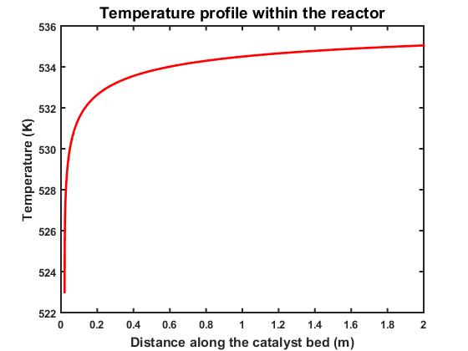
Simulation Results (Contd..)
Objectives
Methanation
Methane Prop.
Liquefaction
Conclusion
12
Notes:
As a laser emits light onto the gas in a test section, the gas absorbs the light and thereby causes the intentuation of the intensity of the incident light.
Beer-Lambert’s law relates the absorbance by a uniform gas intensity of the incident light to the attenuated light intensity which is proportional to the mole fraction of the absorbing specieis where sigma is a gas property (absorption corss-section), total number density of the gas n and optical path-length, L

Slide 13
Simulation Results (Contd..)
Objectives
Methanation
Methane Prop.
Liquefaction
Conclusion
13
Notes:
As a laser emits light onto the gas in a test section, the gas absorbs the light and thereby causes the intentuation of the intensity of the incident light.
Beer-Lambert’s law relates the absorbance by a uniform gas intensity of the incident light to the attenuated light intensity which is proportional to the mole fraction of the absorbing specieis where sigma is a gas property (absorption corss-section), total number density of the gas n and optical path-length, L

Slide 14
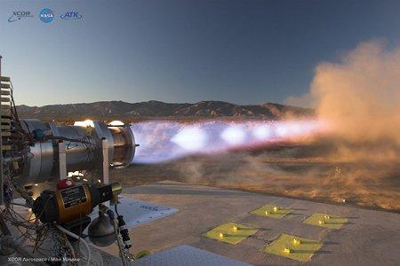
Methane Properties

Slide 15
Helmholtz FR
Objectives
Methanation
Methane Prop.
Liquefaction
Conclusion
15
Notes:
Stainless-steel high-purity
Driven section is 13.5 m and its sepearted from the 4.05 m long driver section separated by a polycarbonate diaphragm, prescored, no razoers
The temperature in shock tube is controlled by the initial pressure in the driven section
Reflected shock pressure is determined by measuring the shck velocity in fixe acially spaced pressure transducers near the shock tube endwall (at end 1.5 m of the shock tube sidewall)
There are also counter timers to prove the time intervals that will describe the propogation of the incident shock
We have the data fromt eh pressure transducers that is fed into a LABView software coupled wth National Instruvments data acquisition to collect data during experiments,
Five axially-spaced pressure transducers along the last 1-2 m of the shock tube sidwarll, starting at about 2 cm from the endwall.
Rapid pressure changes may be picked up with rise times less than 2 microseconds and excite the transducer up to a frequency of 500 kHz,

Slide 16
Results
Objectives
Methanation
Methane Prop.
Liquefaction
Conclusion
16
Notes:
Stainless-steel high-purity
Driven section is 13.5 m and its sepearted from the 4.05 m long driver section separated by a polycarbonate diaphragm, prescored, no razoers
The temperature in shock tube is controlled by the initial pressure in the driven section
Reflected shock pressure is determined by measuring the shck velocity in fixe acially spaced pressure transducers near the shock tube endwall (at end 1.5 m of the shock tube sidewall)
There are also counter timers to prove the time intervals that will describe the propogation of the incident shock
We have the data fromt eh pressure transducers that is fed into a LABView software coupled wth National Instruvments data acquisition to collect data during experiments,
Five axially-spaced pressure transducers along the last 1-2 m of the shock tube sidwarll, starting at about 2 cm from the endwall.
Rapid pressure changes may be picked up with rise times less than 2 microseconds and excite the transducer up to a frequency of 500 kHz,

Slide 17

Separation & Liquefaction

Slide 18
T-s diagram
Objectives
Methanation
Methane Prop.
Liquefaction
Conclusion
13
Notes:
Given that shock #2 occurs at a higher T5, the pyrolysis of propane occurs much faster than for the other two shocks at lower T5.
Therby, Shock #2 has a higher change in absorbance in the allotted time of 1 microsecond than Shock #1 (which has a negligible absorbance change) and Shokc #2 (which has about a 2% change in absorbance over the same amount of time.)
Thereby, we are interested specifically in Shock #2.

Slide 19
Absorbance cross-section
Objectives
Methanation
Methane Prop.
Liquefaction
Conclusion
14
Notes:
Scientific notation

Slide 20
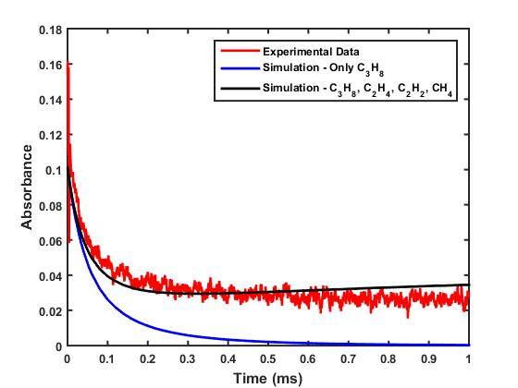
Simulated v. experimentally measured data
Objectives
Methanation
Methane Prop.
Liquefaction
Conclusion
Shock #2
P5 = 0.94 atm
T5 = 1578 K
USC Mech II simulation
Simulation time = 2 ms
Assumptions:
Constant U, V
T₅, P₅ same as Shock #2
Absorption cross-sections for interfering species obtained from Klingbeil’s PhD thesis
Additional unknown C₃H₈ pyrolysis interfering species (e.g., heavier hydrocarbons) unaccounted for
15

Slide 21
Absorbance to mole fraction
Objectives
Methanation
Methane Prop.
Liquefaction
Conclusion
;(
16

Slide 22
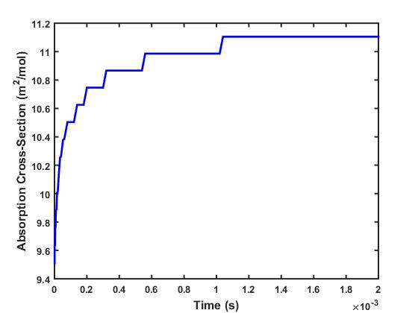
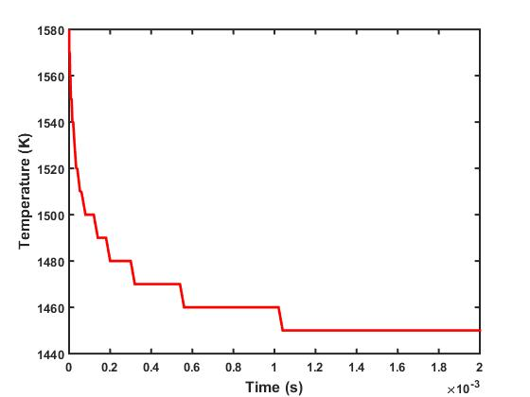
Variation of α as a function of pyrolysis
Objectives
Methanation
Methane Prop.
Liquefaction
Conclusion
10% change in temperature
17

Slide 23
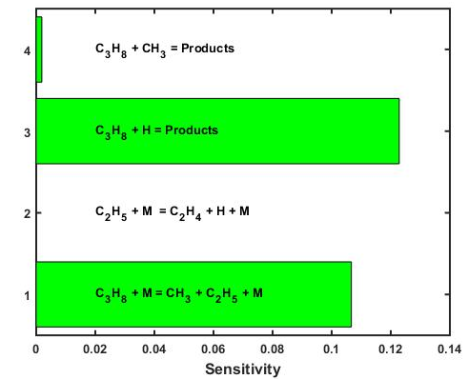
Sensitivity Analysis
Objectives
Methanation
Methane Prop.
Liquefaction
Conclusion
Dominant elementary reactions
C₃H₈ + M = CH₃ + C₂H₅ + M (R1)
C₂H₅ + M = C₂H₄ + H + M (R2)
C₃H₈ + H = H₂ + C₃H₇ (R3)
C₃H₈ + CH3 = CH₄ + C₃H₇ (R4)
Reaction #3 is the most dominant reaction in C₃H₈ pyrolysis
18

Slide 24
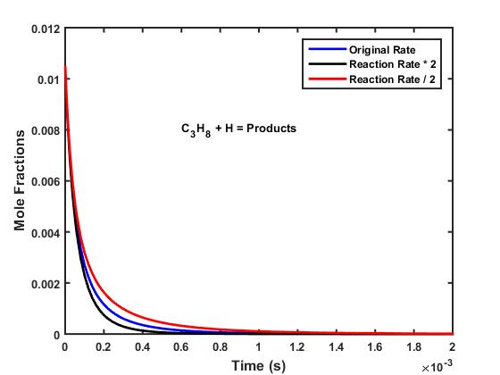
Sensitivity analysis (cont’d)
Objectives
Methanation
Methane Prop.
Liquefaction
Conclusion
Most sensitive elementary reaction
C₃H₈ + H = H₂ + C₃H₇
19

Slide 25
Path going forward
Objectives
Methanation
Methane Prop.
Liquefaction
Conclusion
Discrepancy b/w simulated and measured:
Interference from other species
Discrepancy b/w simulated and measured:
Inaccurate temperature time-history
Use two-color method to get better information about species time-history
Don’t assume T5 is constant, non-intrusive temperature measurement during shock tube test time
Reduce uncertainty in shock velocity measurement
Regularly clean shock tube
Use turbopump
20

Slide 26
Conclusion
Objectives
Methanation
Methane Prop.
Liquefaction
Conclusion
Pyrolysis of propane at elevated temperatures was studied in a shock tube using laser absorption diagnostics
The recorded absorbance signal was used in conjunction with Beer’s law to get the temporal variation of propane mole fraction
Some discrepancy between experimental data and USC Mech II simulation
Methods to reduce discrepancy due to interfering species and temperature change during pyrolysis were proposed
21

Slide 27

Acknowledgements
Prof. Ronald Hanson
Lab #7 TA: Sarah Johnson
22

Slide 28

Backup slides

Slide 29
Adv. of shock tubes as experimental devices
Typical research reactors
Shock tube
Altering initial pressure across diaphragm, the desired shock strength
Known initial temperature and pressure
Well-defined time zero
Rapid/near-instantaneous rapid heat-up of the test gas
Decoupling of kinetics and fluid mechanics
Turbulent plug flow reactor
Rapid compression machine
Laminar, premixed flames
Laminar, diffusion flames
Notes:
By alteration of the initial pressure ratio across the diaphragm, the desired shock strength or quasi-steady flow Mach number may be obtained; this simple method for obtaining various Mach numbers is the main advantage of the shock tube over other research reactors. Additionally….

